Slide 2

Fulfilled. Balanced. Adaptable.

Slide 3
It is a signature program of Opticum, whose vision is a world celebrating inclusive development.

Slide 4
The Life360 Approach & Experience
The Life360 approach and Experience are transformative journeys designed to help you achieve wholeness in every aspect of your life.
The Unique methodology addresses six critical pillars that form the foundation of a fulfilled, balanced, and adaptable life.
Fulfilled focuses on wholeness in the 4 domains
Balanced across 6 foundational pillars
Adaptable to changing circumstances- life is to be lived intentionally

Slide 5
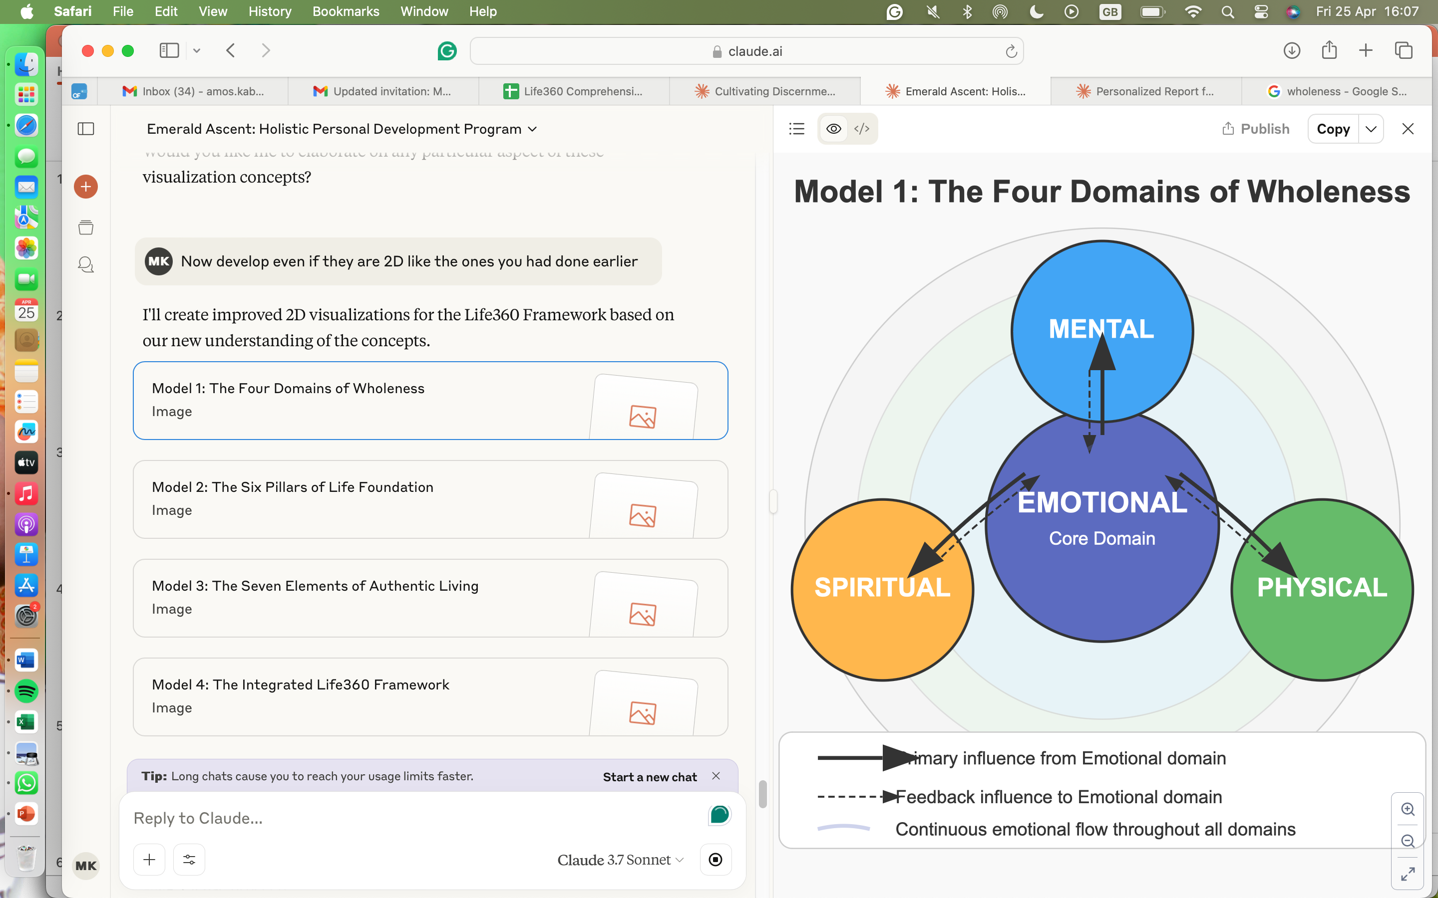
Domains of wholeness
3 John 1:2:
"Beloved, I pray that you may prosper in all things and be healthy, just as your soul prospers.”

Slide 6
Foundational Pillars of Wholeness
Personal Value System
Career and Academics
Finances
Social Networks
Family
Spirituality

Slide 7
The 7 Principles of Life360
The experience follows carefully tried and tested 7 principles that facilitate authentic living. The principles include:
Examining Life Patterns
Intentional Reflection
Building Support Systems
The Practice of Solitude
Planning for Disappointment
Habit Formation and Character Development
Life as an Integrated Whole

Slide 8
Our Core Values
We are intentional to learn
We embrace continuous growth through deliberate
We respect all
We honour the inherent dignity and worth of every
We exercise empathy
We seek to understand others' experiences and
practice, curiosity, and openness to new perspectives.
compassion and genuine care.
individual, creating
space for authentic expression and diverse viewpoints.
perspectives, responding with

Slide 9



Our Focus
Family at the Core We believe that family is the foundation of success and stability in every institution, whether a school or a church.
Support for Churches We work with churches because we believe the body of Christ is held together by strong, thriving families
Partnership with Schools Thriving families raise better students and teachers, leading to stronger academic outcomes and more nurturing school environments.

Slide 10
Our Programs
Our programs are classified into:
The Flowering
The Climb
Customised programs

Slide 11
The flowering focuses on the formation of the value system
Bud: For adolescents navigating identity and purpose
Bloom: For college/university students preparing for professional life
Spore: For post-college/university individuals before entering the workforce

Slide 12


Slide 13
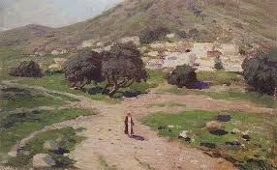
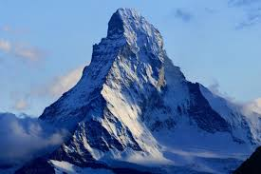
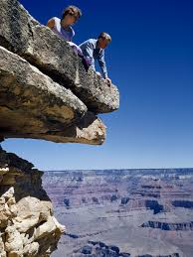
The Three Climb
The Ascent
The Summit
The Cliff

Slide 14
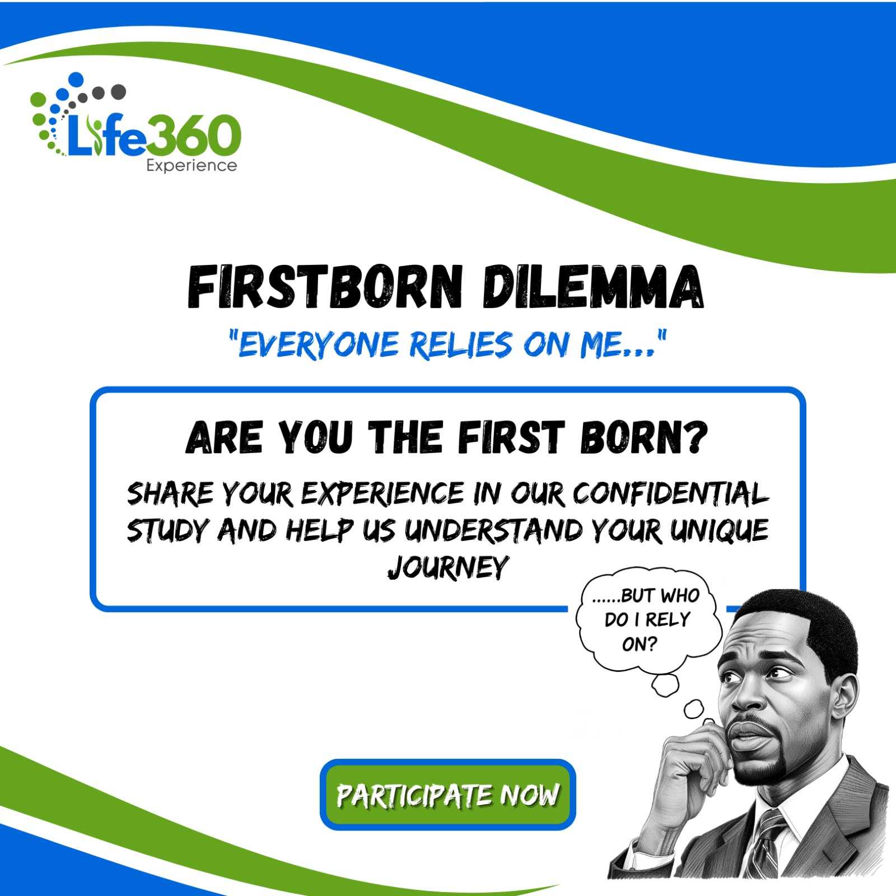
Family and Institutional Strengthening
Masterclasses and seminars for family development
Programs for religious institutions
Educational institution support and transformation
Relationship-building across generations

Slide 15
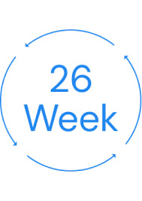
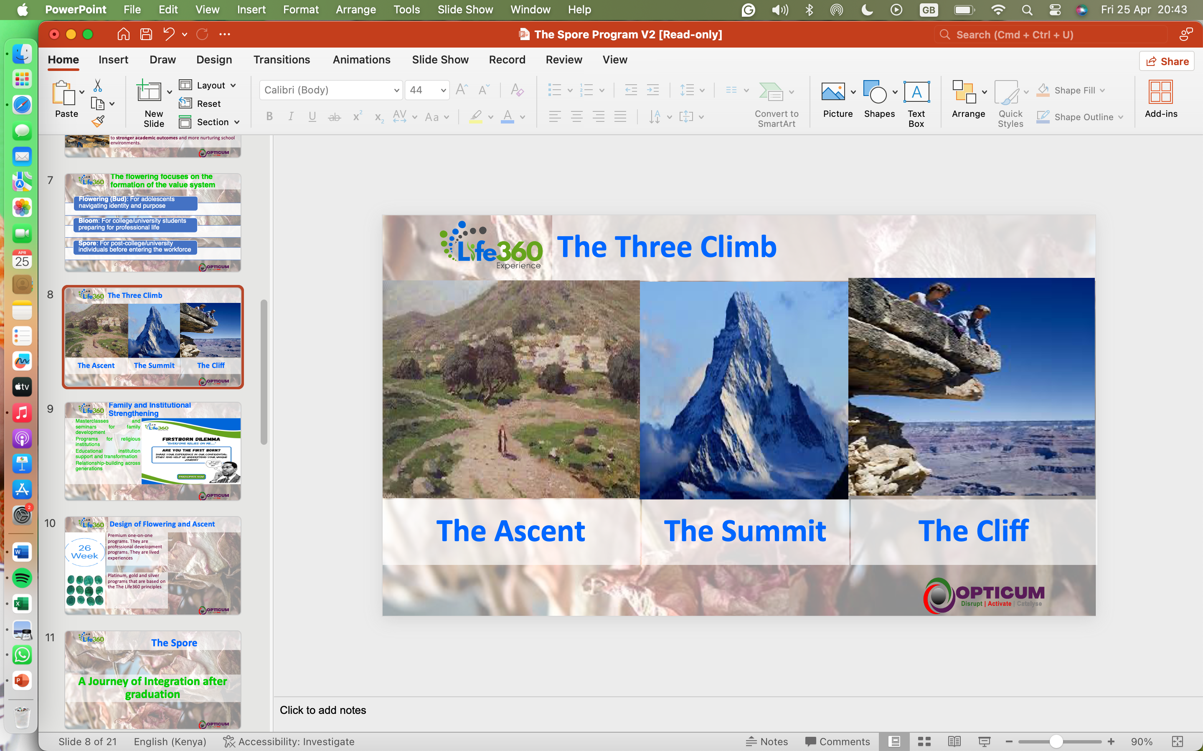

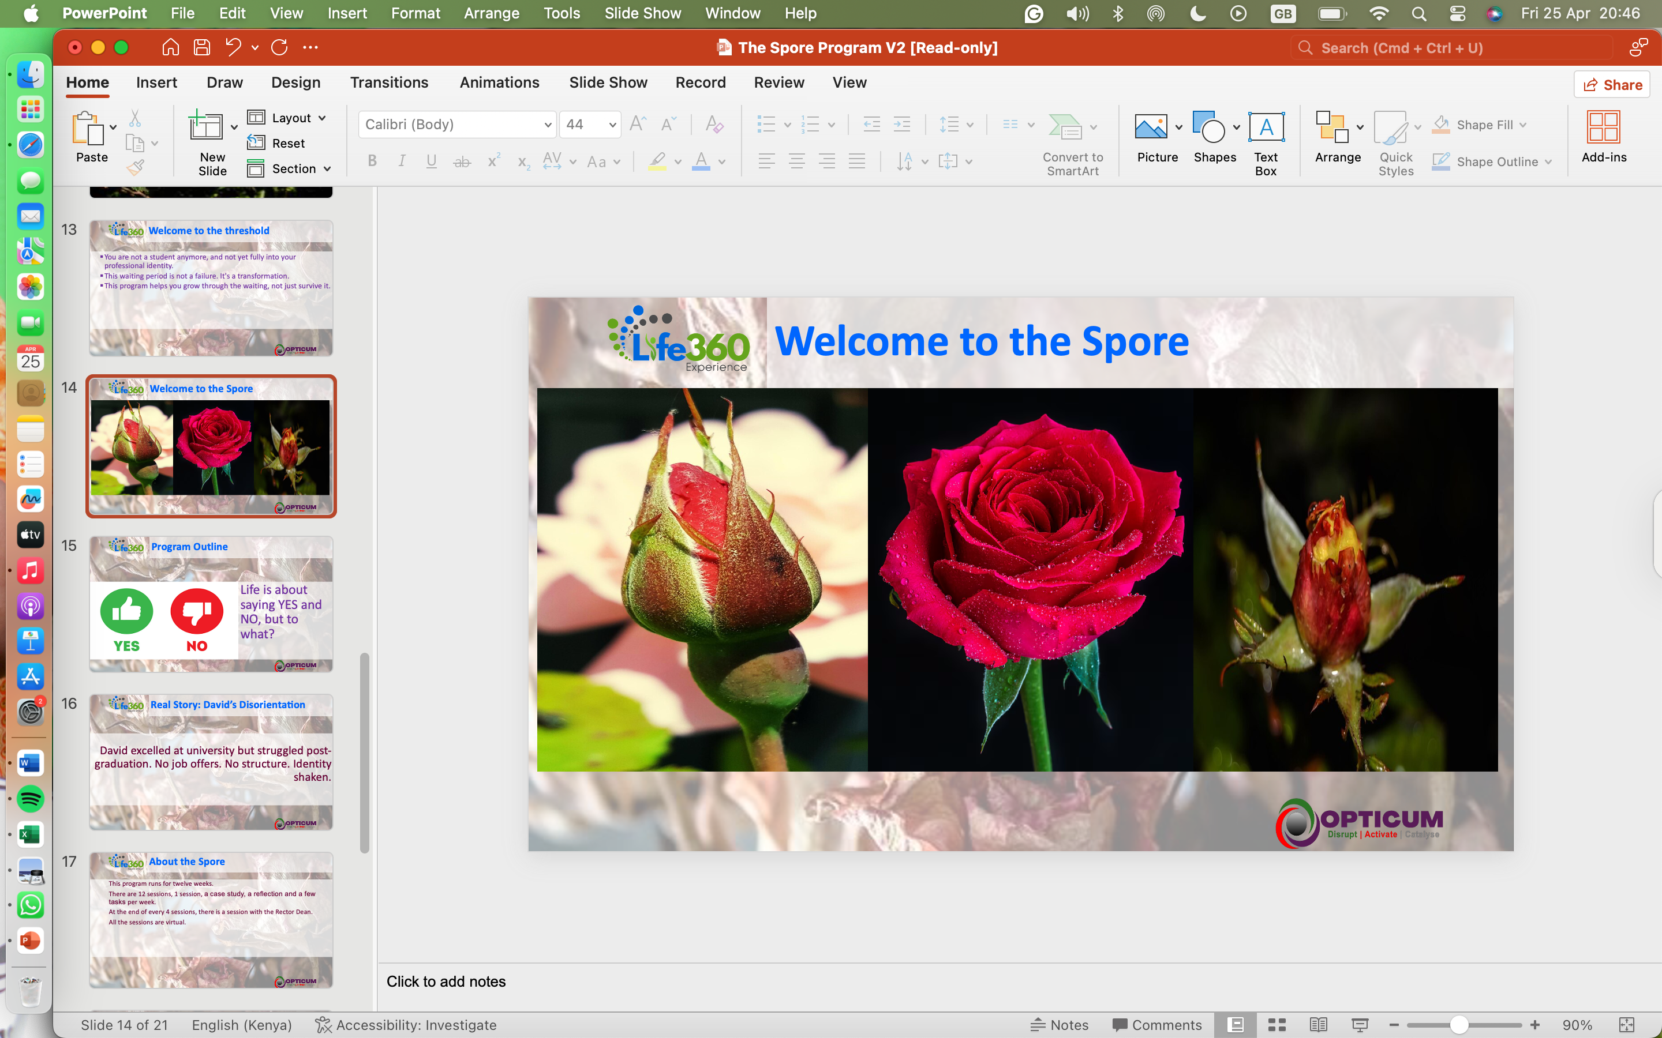
Design of Flowering and Climbing
Premium one-on-one programs. They are professional development programs. They are lived experiences
Platinum, gold and silver programs that are based on the Life360 principles.
They are considered Emerald

Slide 16
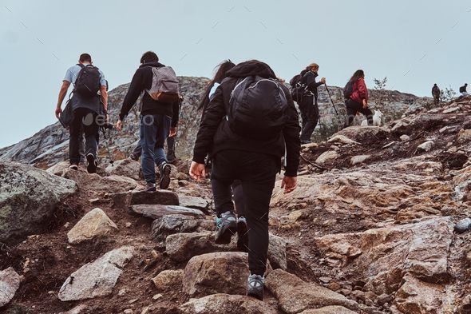
The
Ascent Series

Slide 17
Welcome to the threshold
You are a young person, probably between the ages of 22 and 34.
Your career or business has just taken off, and you are new in the game.
At this stage of life you are grappling with difficult decisions to make which would potentially shape the rest of your life.
This is the time to make those difficult decisions and have those uncomfortable conversations.
This program helps you to not only have those difficult conversations but also make and execute those difficult decisions for the greater good.

Slide 18

Program Outline
Life is about saying YES and NO, but to what?

Slide 19
About the Ascent
The Emerald
Study of the 7 principles of the Life360 and journaling of feelings
Undertaken over 12 weeks through 12 sessions
A session includes a case study, reflection questions, and tasks that help with journaling
Includes 3 sessions with the Rector Dean (one meeting in month)
Is undertaken as a platinum/gold
The Deep Dive
It is an immersion of 7 experiences that make up the Life360 Experience
It is undertaken over 26 weeks
Each element has distinct features and demands
Includes 8-12 sessions with the Rector Dean (At each stage, with 3 meetings dedicated to reflective sessions
Preferred to be undertaken as Gold (groups of 3-5 individuals), but can also be undertaken as Platinum.

Slide 20
Elements of the Life360 Experience
Comprehensive Assessment
18 Reflective Sessions
Artistic Impression
Horizon Challenges
Solo retreat
Project of Purpose
Wisdom Council

Slide 21
The process
No | Element | Process
1 | Comprehensive Assessment | Psychometric assessment of 20 questions. Report in 72 hours. Program placement within 24 hours
2 | Reflective Sessions | 18 sessions undertaken over 6-9 weeks. Organised in 3 parts: Problem awareness, coping mechanisms and intentional living
3 | Artistic Impression | Starts after session 6 of reflections. Involves between 2-4 sessions. May also include seeing a pyschologist. Art seen after solo retreat
4 | Horizons to the Birthday | Challenges equivalent to the upcoming birthday. Undertaken over the number of days/weeks
5 | Wisdom Council/Personal Board | 5- 7 personal advisors to guide one and post experience
6 | Solo Retreat | A new environment. Takes a whole weekend. Guided, 3 options and then Facilitators
7 | Personal SP | Vision board for the big birthday upcoming. May also include a legacy project.

Slide 22
Your Investment
You will cough up a few hundred dollars, and then 10% will be a tithe. And you know what, a huge discount awaits you.

Slide 23
Our Facilitators
Our team of facilitators include the:
The Rector Dean
The Life360 Activator
The Clinical Psychologist
The facilitator of your Solo Retreat.
The facilitator of artistic expression.

Slide 24
Our Contact
Physical location: 22 School Lane(Block B. 1st Floor @Usawa Agenda Offices)
Postal Address: P.O. Box 44992 – 00100
Phone: +254 753167442
Email: welcome@opticume.com
Website: www.opticume.com
www.thelife360experience.com

